Slide 1
Methods for copy number variation: hidden Markov model and change-point models

Slide 2
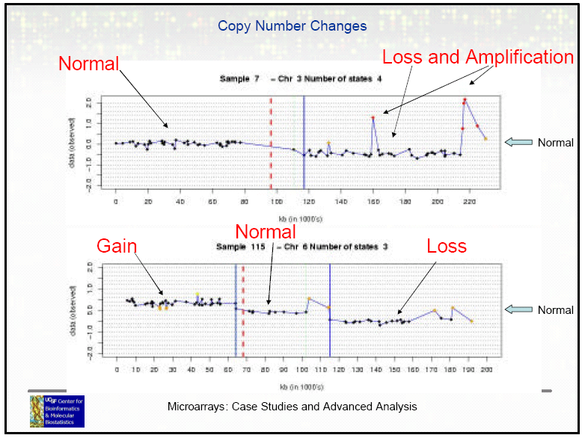
Copy Number Variation/Alteration

Slide 3
Technological improvement:
Array CGH
2000-6000 probes in an array (using Bacteria Artificial Chromosome (BAC) clones at ~100kb in size).
Low resolution
SNP array
Millions of probes in an array (using oligo probes targeted on known SNPs at 21-60 bp in length)
High resolution
Next generation sequencing
Measurement of each base pair
Highest resolution

Slide 4
Given data, how to call copy number variation?
Goal: To partition probe units into sets with the same copy number and characterize genomic segments
Two elements to estimate:
Copy number change location or regions
Copy number change magnitude (amplification, deletion and fold change)

Slide 5
Methods
Threshold-based methods (single marker classification)
(a) Direct thresholding from contrast experiments such as sex mismatched experiment, SKY or FISH.
(b) Thresholding from K-means clustering or mixture Gaussian model.
(c) Moving average based thresholding.
Hidden Markov model (HMM)
Change-point model; Circular Binary Segmentation (CBS)
Wavelet analysis
Genetic local search

Slide 6
References
Methods:
(HMM) Hidden Markov models approach to the analysis of array CGH data (2004)
(CBS) Circular binary segmentation for the analysis of array-based DNA copy number data (2004)
(a Bayesian approach to extend change-point model) A versatile statistical analysis algorithm to detect genome copy number variation (2004)
(Wavelet) Denoising array-based comparative genomic hybridization data using wavelets (2005)
Review:
Statistical issues in the analysis of DNA copy number variations (2008)
Computational methods for the analysis of array comparative genomic hybridization (2006)
Comparative studies:
A comparison study: applying segmentation to array CGH data for downstream analyses (2005)
Comparative analysis of algorithms for identifying amplifications and deletions in array CGH data (2005)

Slide 7
Gaussian mixture model

Slide 8
Gaussian mixture model
work well
doesn’t work
Gaussian mixture model

Slide 9
Change-point model

Slide 10
Change-point model
Binary segmentation procedure:

Slide 11
Change-point model
To apply to a CNV application, the hypothesis testing of the change-point model is applied iteratively to identify change points T₁, T₂,…, until the hypothesis testing is not rejected.
What’s the problem of this change-point model approach?
If there is a small CNV segment in between two long unchanged regions, the hypothesis testing will not be rejected in the first evaluation.
The problem is that the change points are detected one-by-one.
=> Extension to “Circular Binary Segmentation”

Slide 12
Circular Binary Segmentation
Detect two change points at a time:

Slide 13
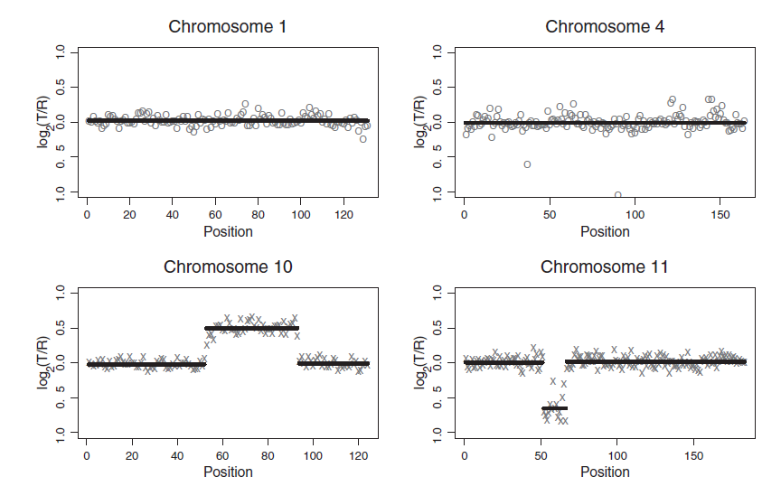
Circular Binary Segmentation
Figure 1. Olshen et al., 2004

Slide 14
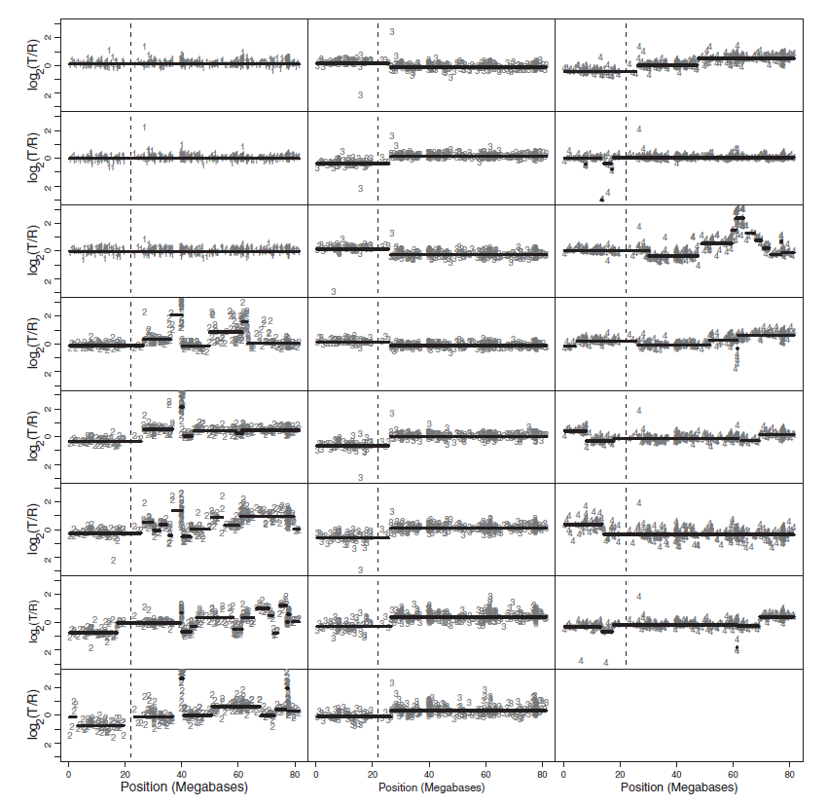
Circular Binary Segmentation
Figure 3. Olshen et al., 2004

Slide 15
Hidden Markov model
© Jun S. Liu

Slide 16
Hidden Markov model
© Jun S. Liu

Slide 17
Hidden Markov model
© Jun S. Liu

Slide 18
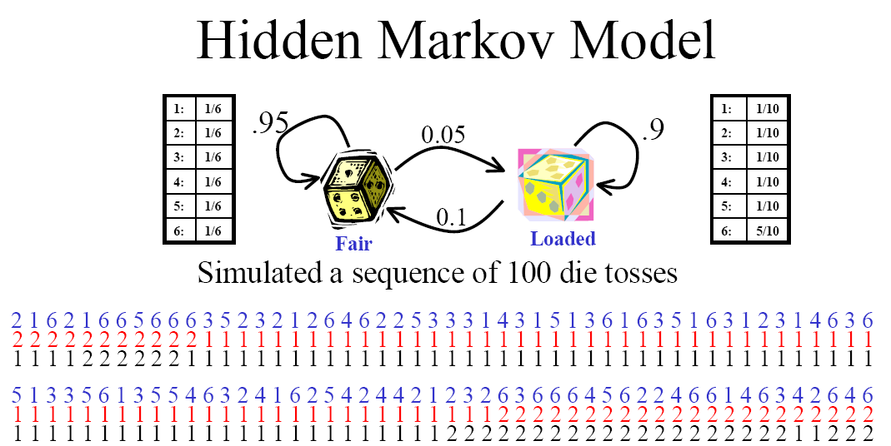
Hidden Markov model
© Jun S. Liu

Slide 19
Hidden Markov model

Slide 20
Hidden Markov model

Slide 21
Hidden Markov model

Slide 22
Hidden Markov model

Slide 23
Hidden Markov model

Slide 24
Hidden Markov model

Slide 25
Hidden Markov model

Slide 26
Hidden Markov model

Slide 27
Hidden Markov model

Slide 28
Hidden Markov model

Slide 29
Hidden Markov model

Slide 30
Hidden Markov model
Currently, SNP array has mostly replaced aCGH for cheap price and very high density.

Slide 31
Hidden Markov Model
Hidden Markov Model (HMM) is widely used for sequential data analysis.
HMM is a simple case in Bayesian Networks (BNs)
It is a generative model: a model for randomly generating the observed data. (compare to discriminative model)
It assumes large number of conditional independencies.
Computational complexity is low.

Slide 32
Graphical Representation
Hidden layer (unobserved states)
transition
emission
Observed Data

Slide 33
Questions
Evaluation:
Given the model and its parameters, what is the probability of generating the data we observed? (likelihood)
Decoding:
Given the parameters and observed data, can we know the sequence of hidden states? (When did the dealer use loaded dice?)
Learning:
If the probabilities (initial, transition, emission) are unknown, can we estimate them from the observed data? (Parameter estimation)

Slide 34
Array CGH Example (1)
In normal tissues, each of the chromosomes (except for X and Y) should have 2 copies.
In cancer tissues (or other disease), the chromosomes may suffer from events like amplification and deletion. Thus the cancer chromosome will more or less than 2 copies.
Array CGH hybridize the cancer tissue and normal tissue, and measures the copy number change (log2 ratio).
Copy number change happens in segments.
Measured data is not perfect (noisy).

Slide 35
Array CGH Example (2)

Slide 36
Array CGH Example (3)

Slide 37
Evaluation
Find P(X=x) given all parameters, without knowing the probabilities.
A naïve thinking
P(X=x)=∑_{y} P(X=x,Y=y)=∑_{y} P(Y=y)P(X=x|Y=y)
We can brute force all the possible sequences of Y
Very expensive in computation (Not feasible)
But we can observe that in this formula, a lot of computations are redundant. We can combine them to save time.

Slide 38
Forward Algorithm
Define: α_{n}^{k}=P(x₁,…x_{n},y_{n}=k)
Initialize: α₁^{k}=P(x₁,y₁=k)=π_{k}P(x₁|y₁=k)
Iteration: α_{n+1}^{k}= P(x_{n+1}|y_{n+1}=k)∑_{i} α_{n}^{i}a_{i,k}
Finalize: P(x)=∑_{k} α_{N}^{k}

Slide 39
Decoding
Local decoding:
Backward algorithm
y_{n}*=argmax P(y_{n}|X=x)
Global decoding:
Viterbi algorithm
y*=argmax P(y|X=x)

Slide 40
Backward Algorithm
Define: β_{n}^{k}=P(x_{n+1},…,x_{N}|y_{n}=k)
Initialize: β_{N}^{k}=1
Iteration: β_{n}^{k}=Σ_{i}a_{k,i}P(x_{n+1}|y_{n+1}=i)β_{n+1}^{i}
Finalize: P(x)=Σ_{k}α₁^{k}β₁^{k}
Posterior: P(y_{n}=k|x)=α_{n}^{k}β_{n}^{k}/P(x) ∝α_{n}^{k}β_{n}^{k}
Decoding: y_{n}*=argmax P(y_{n}|x)

Slide 41
Viterbi Algorithm
Goal: y*=argmax P(y|X=x) ≡ find max P(y,x)
Define: γ_{n}^{k}=max P(y₁,…,y_{n-1},y_{n}=k,x₁,…,x_{n})
Initialize: γ₁^{k}=α₁^{k}
Iteration: γ_{n+1}^{k}=p(x_{n+1}|y_{n+1}=k) max_{i} γ_{n}^{i}a_{i,k}
Finalize: max P(y,x)=max γ_{N}^{k}
Traceback:
In iteration, record the maximizer i for each γ_{n}^{k} (n>1), i.e. record δ_{n}(k)=argmax_{i} γ_{n}^{i}a_{i,k}
y_{N}*=argmax γ_{N}^{k}
y_{n}*=δ_{n+1}(y_{n+1}*)

Slide 42
Learning
Parameters θ (initial, transition and emission probabilities/parameters) are usually unknown.
Here total S sequences (subscript s) are considered sharing the same θ
x is observed, y is unobserved
MLE: argmax L(θ;x)=argmax P(x|θ)=argmax Σ_{y}P(x,y|θ) ------ Intractable
E-M algorithm (Baum-Welch algorithm)

Slide 43
E-M Algorithm
E-step (expectation):
Calculate the expectation of log-likelihood (sufficient statistic) given the current estimate θ^{(t)} and observed data x
Q(θ|θ^{(t)})=E_{y|x,θ}(t)[log L(θ;x,y)]
M-step (maximization):
Maximize Q(θ|θ^{(t)}) and update the estimate of θ
θ^{(t+1)}=argmax_{θ} Q(θ|θ^{(t)})
Repeat E-step and M-step till convergence

Slide 44
Baum-Welch Algorithm
E-step:
ζ_{s,n}(i)=P(y_{s,n}=i|x_{S}, θ^{(t)})
ξ_{s,n}(i,j)=P(y_{s,n}=i,y_{s,n+1}=j|x_{S}, θ^{(t)}) ------ exercise
M-step:
Initial: π_{i}^{(t+1)}=Σ_{s} ζ_{s,1}(i)/S
Transition: a_{i,j}^{(t+1)}=[Σ_{s}Σ_{n<Ns}ξ_{s,n}(i,j)]/[Σ_{s}Σ_{n<Ns}ζ_{s,n}(i)]
Emission: P(x_{s,n}|y_{s,n}=k) depends on the distribution type. Generally, estimate the distribution parameters using ζ and ξ as pseudo-counts (partial/probability counts).
Repeat E-step and M-step till convergence

Slide 45
Tips
E-M algorithm aims to find the MLE
E-M algorithm is guaranteed to converge
E-M algorithm is not guaranteed to converge to the global maximum
When programming your own HMM, be aware of data underflow (numbers too close to zero)
Use log transformation
Store scale parameters in each iteration (Forward, Backward and Viterbi)

Slide 46
HMM and Other Methods
Naïve Bayes/Mixture Model
HMM
Y_{i}
Y₁
Y₂
Y₃
X_{i}
X₁
X₂
X₃

Slide 47
Computer Program for HMM
R Package “HMM”
R Package “msm”
“HMM” toolbox for Matlab
…
Make your own code
Matlab, C, Java, …
Do not use pure R code (too slow)

